Slide 1
Software Requirements Engineering

Slide 2
Agenda
Kano’s Model
Selection of elicitation techniques
Categorization of elicitation techniques by IREB
Software requirement Elicitation Methodologies

Slide 3
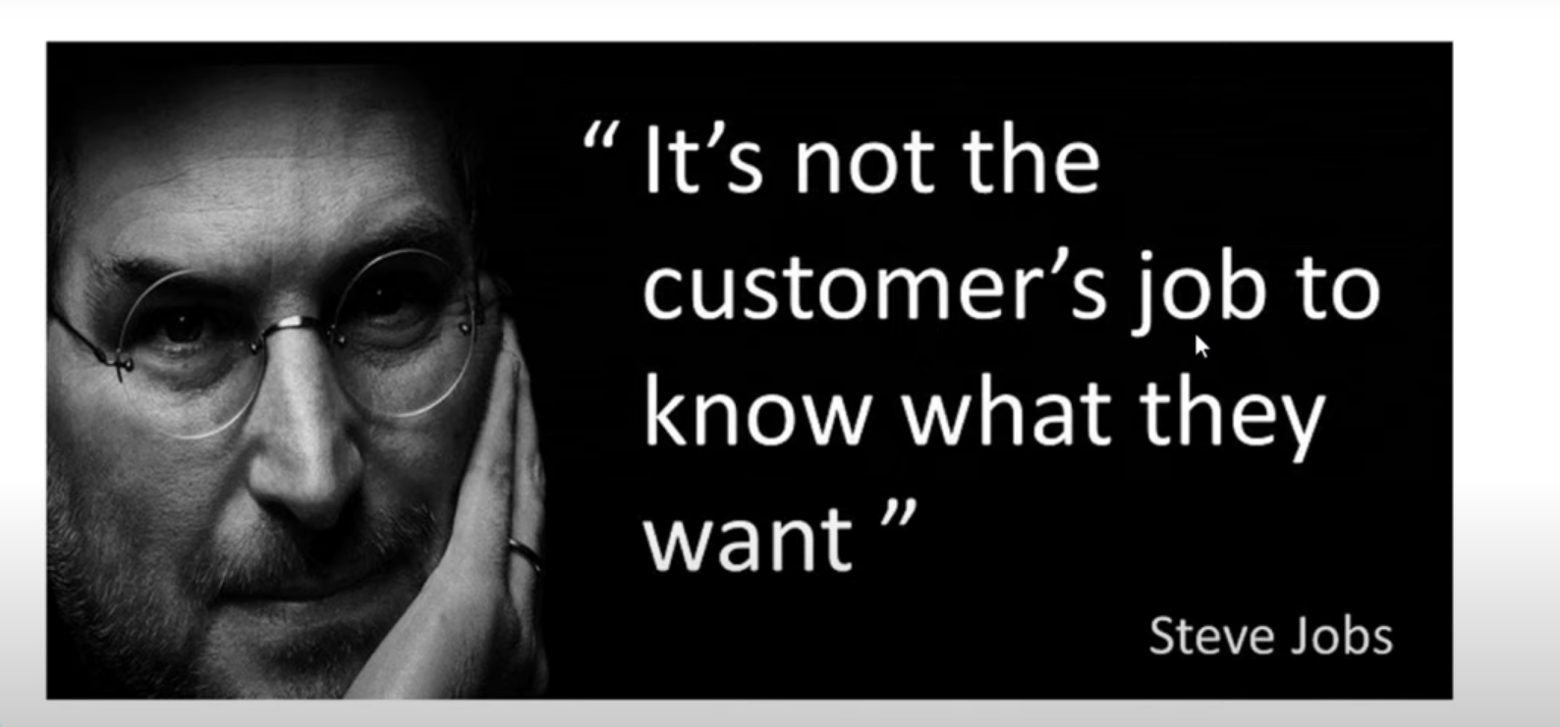
Kano’s Model

Slide 4
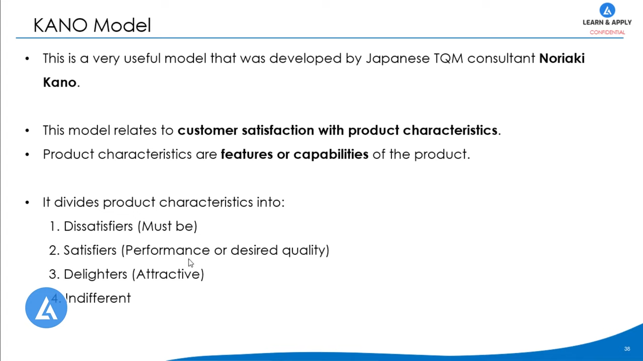
4.

Slide 5
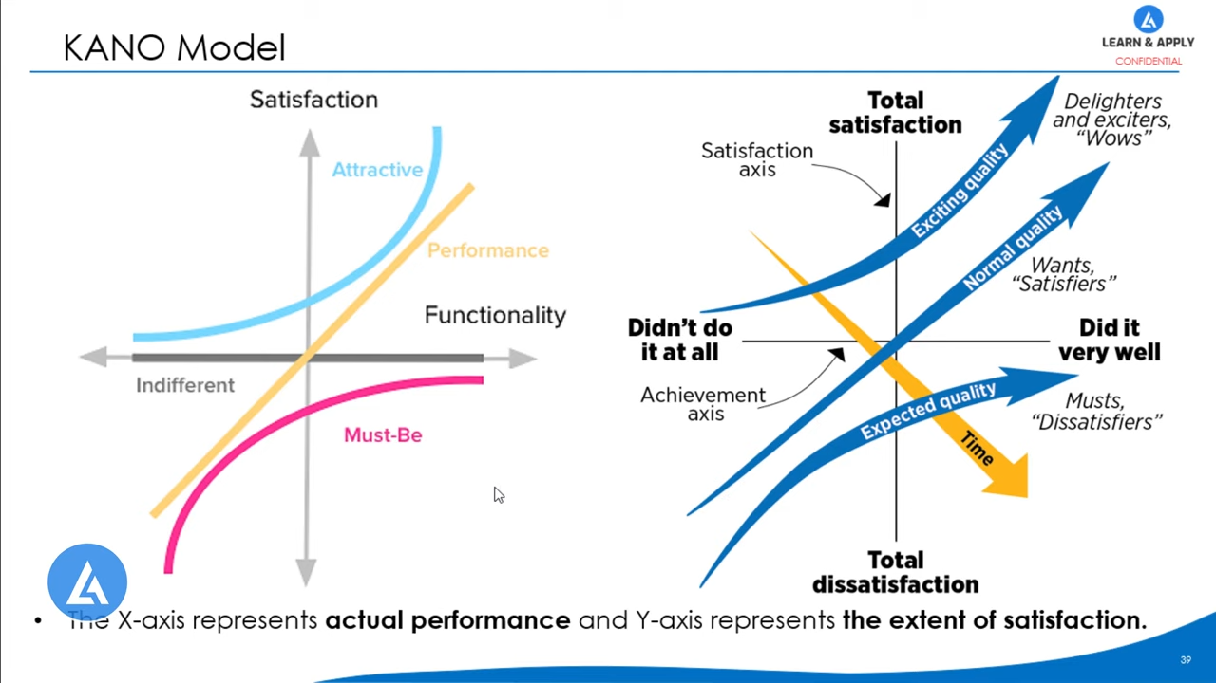
4.

Slide 6
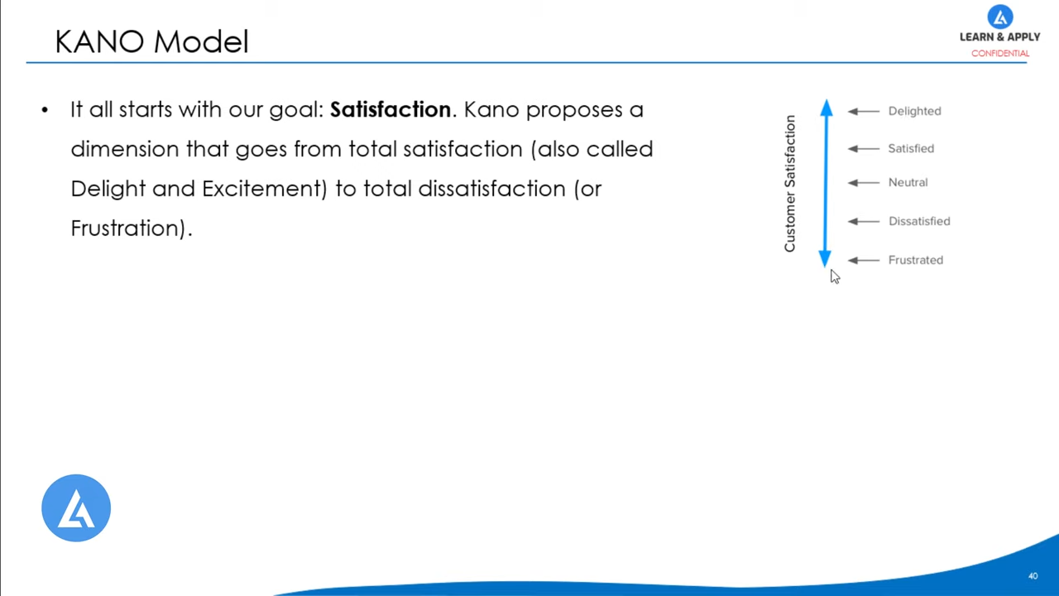
4.

Slide 7
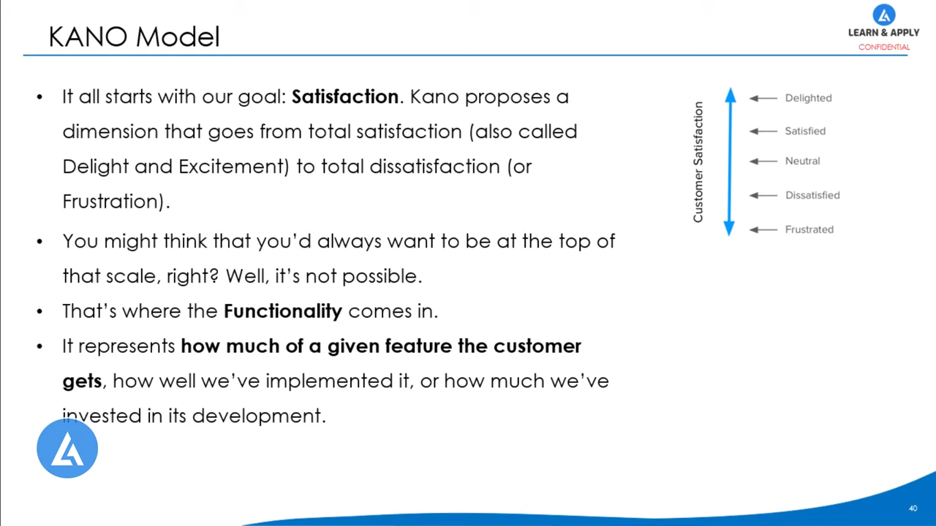
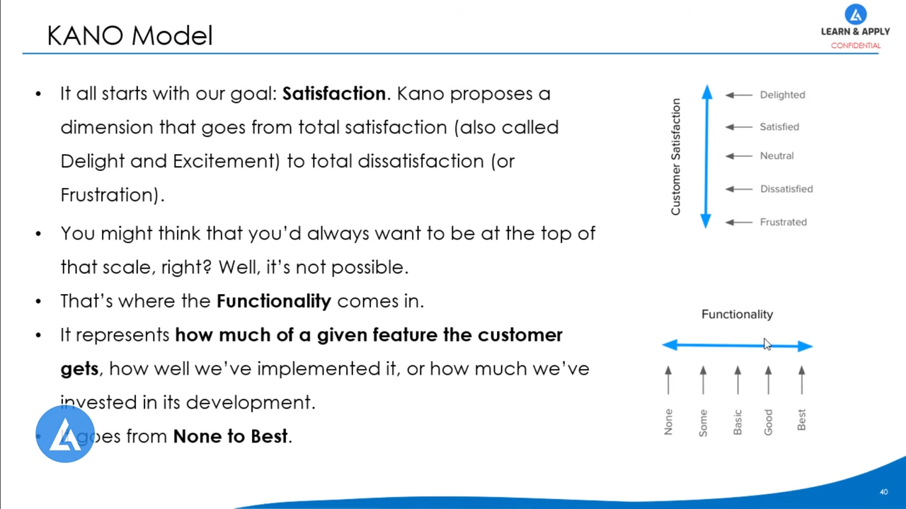
It goes from None to Best

Slide 8
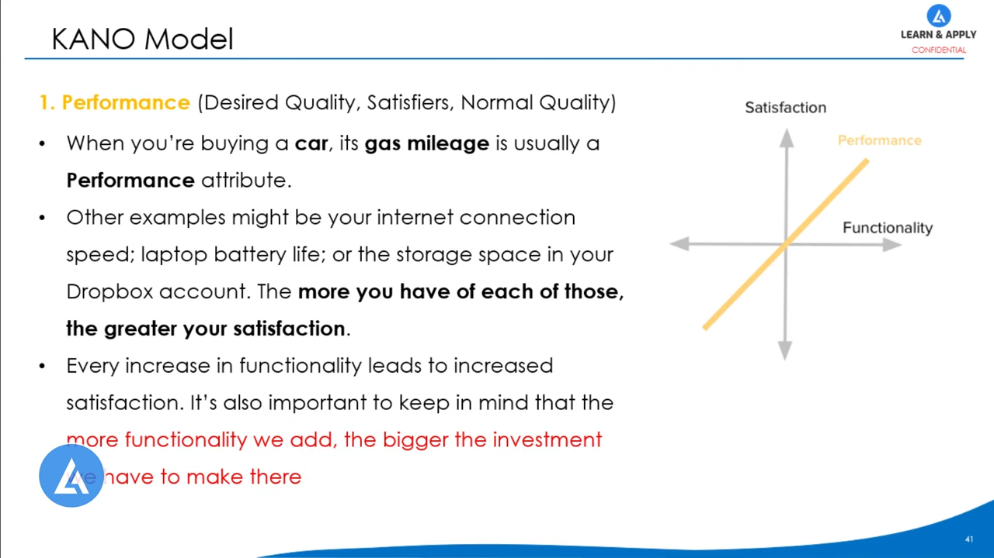
more functionality we add the bigger the investment we have to make there

Slide 9
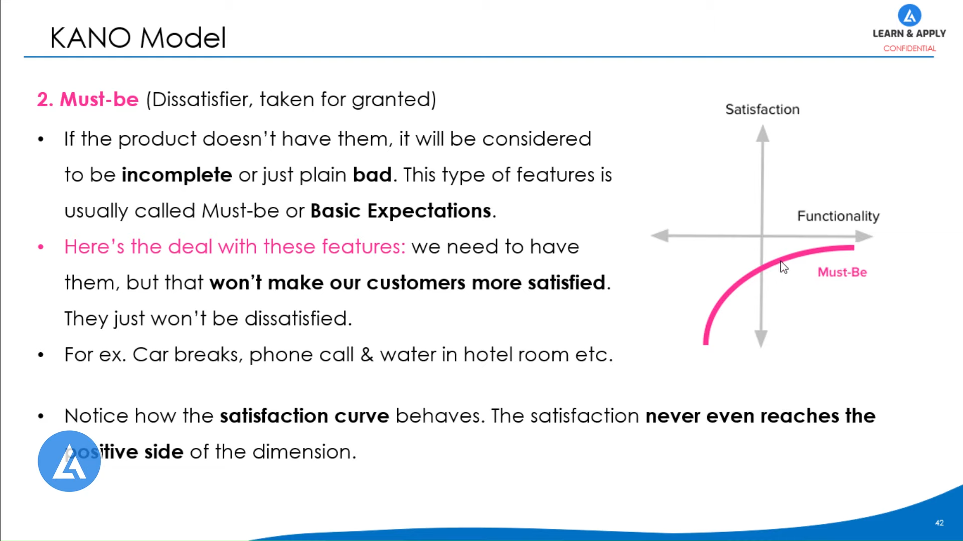
positive side of the dimension

Slide 10
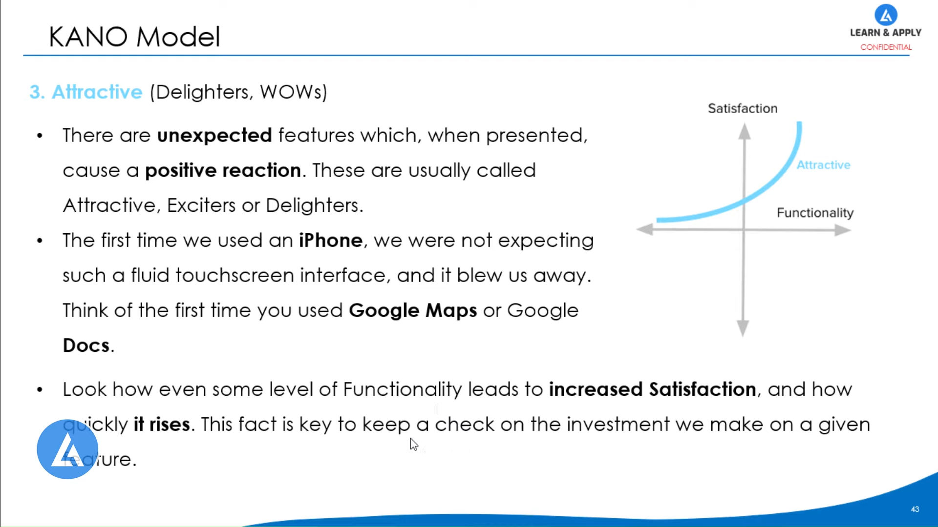
4.

Slide 11
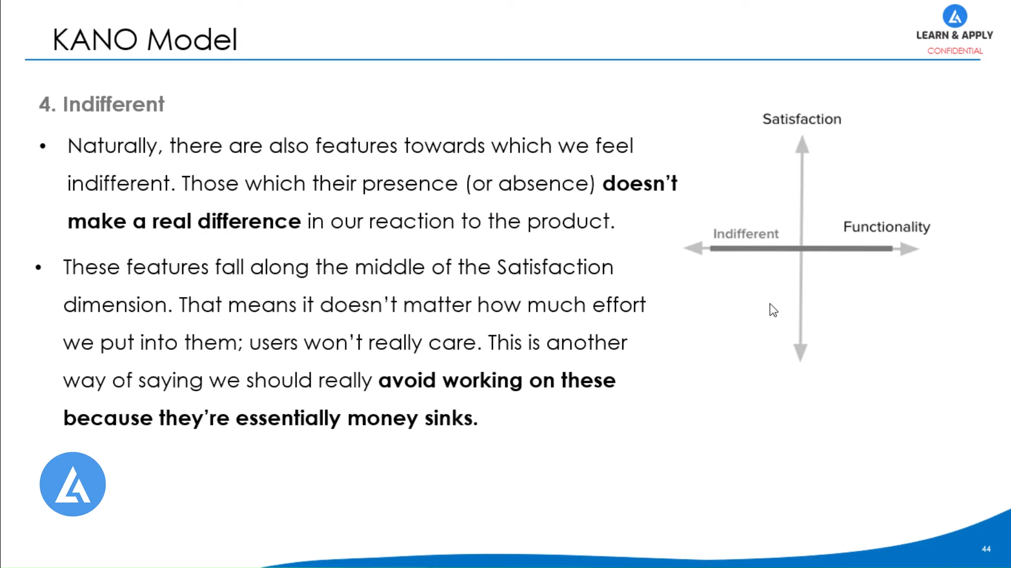
4.

Slide 12
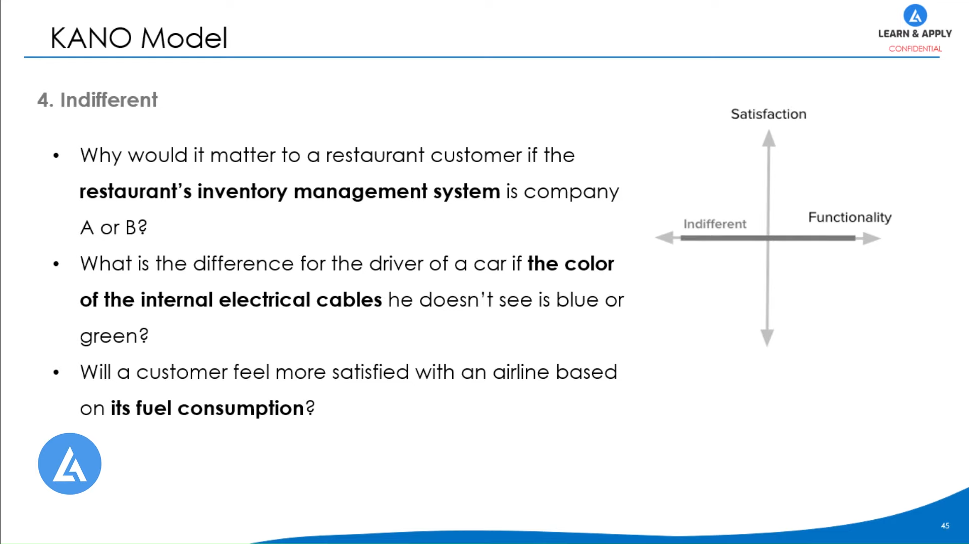
4.

Slide 13
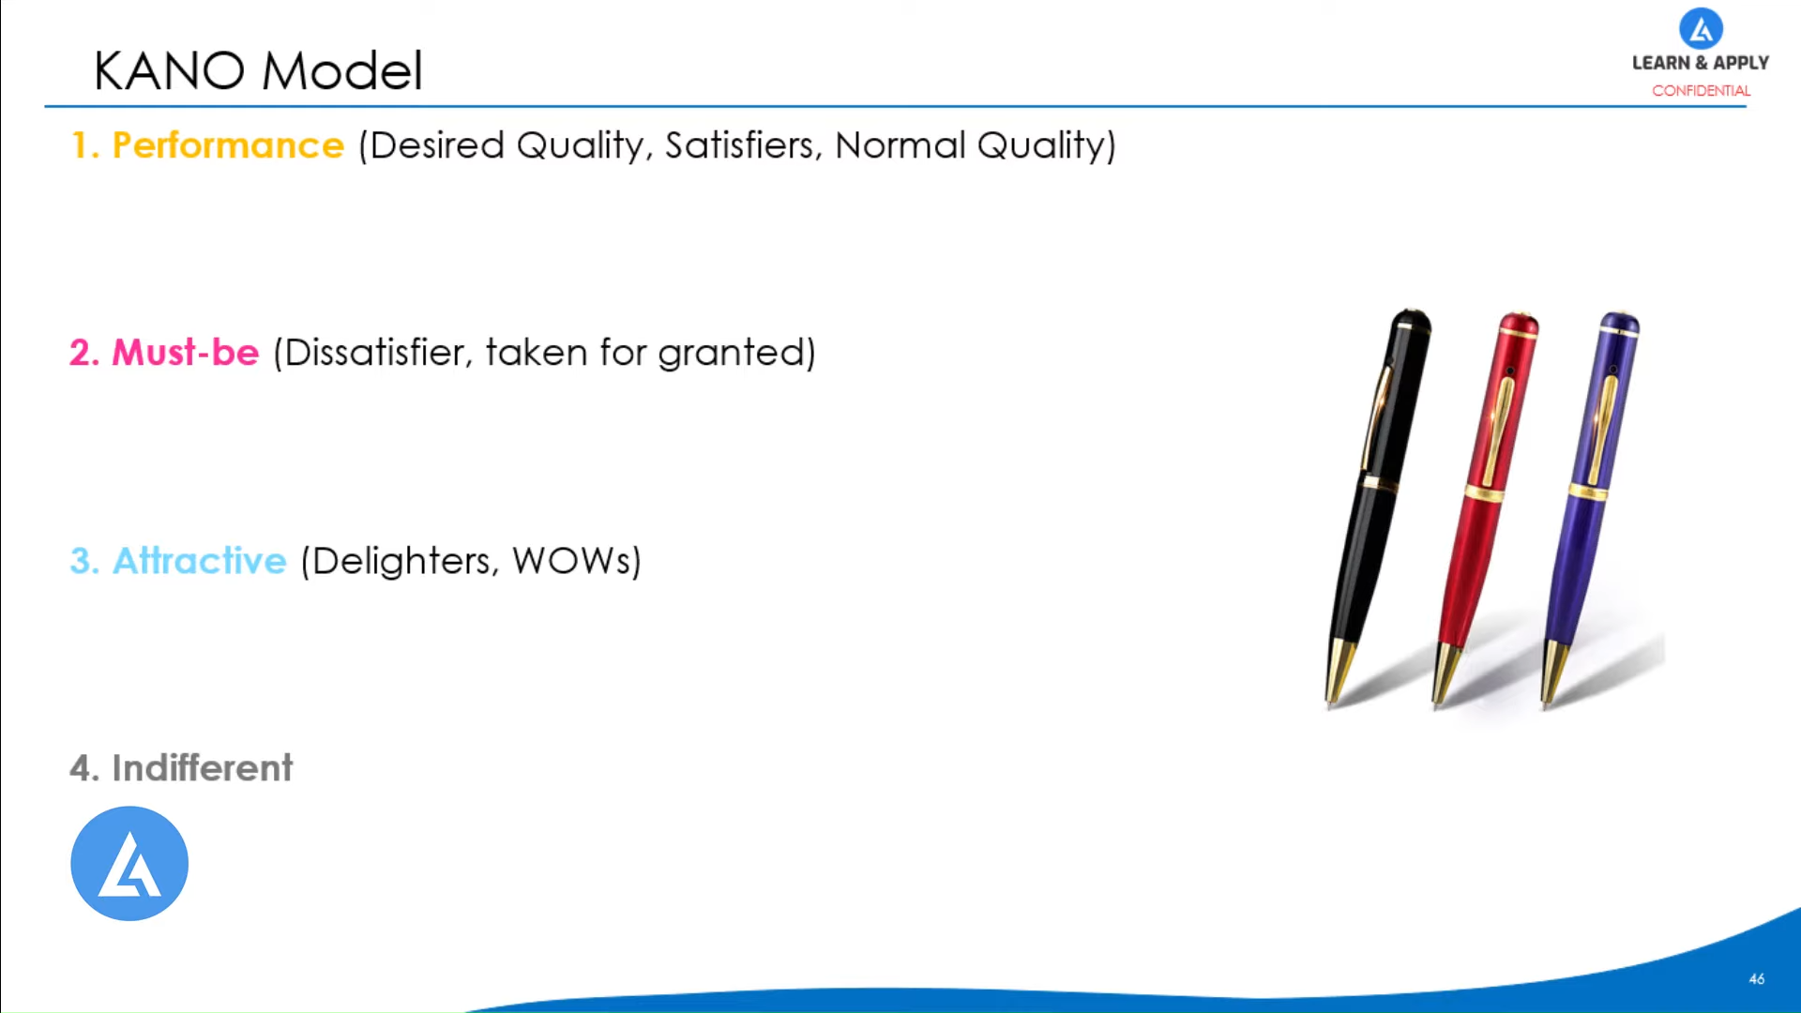
4.

Slide 14
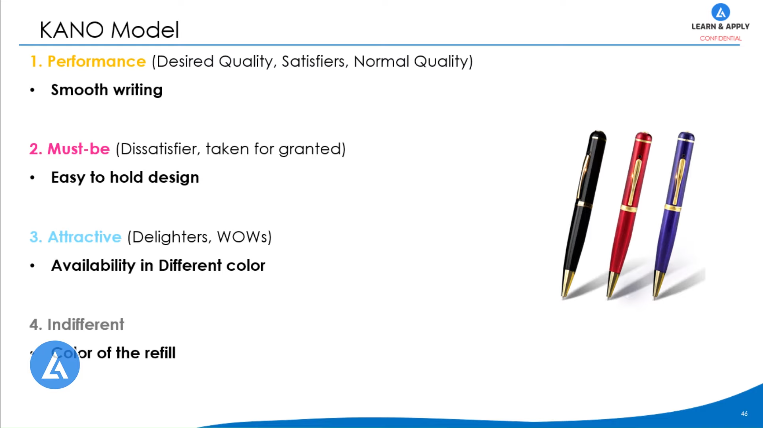
Color of the refill.

Slide 15
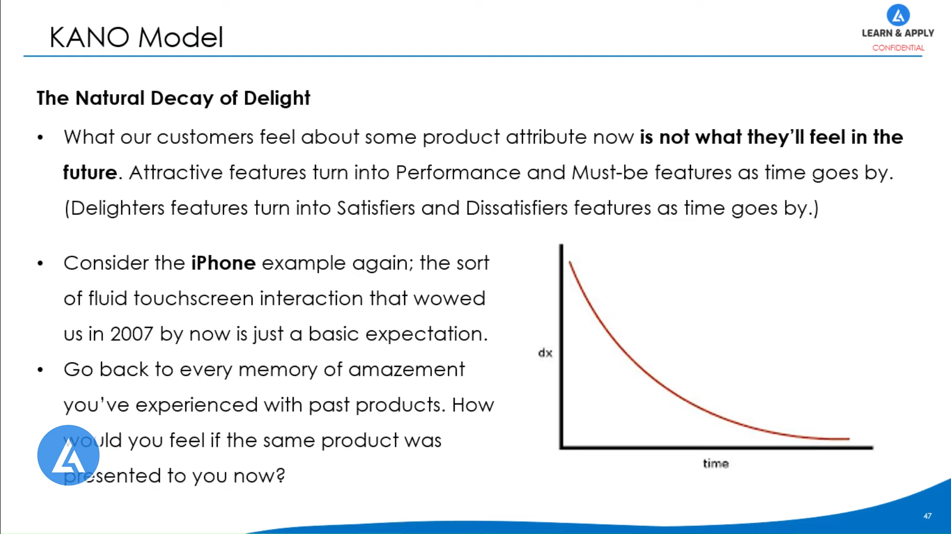
would you feel if the same product was presented to you know?4.

Slide 16
Selection of elicitation techniques
The main goal of all elicitation techniques is in supporting the requirements engineer in ascertaining the knowledge and requirements of the stakeholders.
How and when a technique can be applied depends on the given conditions.

Slide 17
Influencing factors regarding the choice of elicitation techniques
There is no universal method to elicit conscious, unconscious, and subconscious stakeholder requirements [Hickey and Davis 2003].
Every project has individual constraints and individual characteristics and is by and large unique, but there are always elicitation techniques that are compatible with the project.

Slide 18
Influencing factors regarding the choice of elicitation techniques
The first important step when choosing a suitable elicitation technique is to perform an analysis of constraints critical to the project, i.e., identifying so-called risk factors. Mostly, these result from human, organizational, and professional influences.

Slide 19
Human influences
During the requirements elicitation phase, which is heavily influenced by the stakeholders, good communication is essential. In order to assure high-quality communication between the requirements engineer and stakeholders, it is important to determine
the type of requirement,
the desired level of detail,
and the experience of the requirements engineer
and the interviewees with different elicitation techniques.
Social, group-dynamic, and cognitive capabilities of the stakeholders also influence the choice of suitable elicitation techniques significantly.

Slide 20
Another influence factor is whether the elicited knowledge is explicit (consciously known) by each individual stakeholder or if it is implicit or unconscious (i.e., covert).

Slide 21
Organizational risk factors
Organizational risk factors need to be investigated as Organizational influences well. Among other things, this comprises the distinction between fixed price contracts and service contracts, whether the system to be built is a new development or an extension of a legacy system, and spatial and temporal availability of the stakeholders.

Slide 22
In addition, it is necessary to consider the operational content of the requirements. If the system is very complex, it is advisable to employ a structuring approach during elicitation in order to deconstruct the operational contents into understandable parts.

Slide 23
Level of abstraction
Another influencing factor on the choice of elicitation techniques is the desired level of detail of the requirements.
Abstract requirements can be elicited rather well using creativity techniques. With the stakeholders, a vision of the system or its important properties can be created or collected.
Inquisitive (survey) techniques or observational techniques can aid in eliciting requirements of a medium level of detail [Robertson 2002].
Finely detailed requirements can be elicited well by making use of document centric techniques, i.e., techniques that use existing documents because information up to an arbitrary level of detail can be extracted from these.

Slide 24
Combining elicitation techniques
It is advisable to combine different techniques because this minimizes many of the risks inherent to the project. Weaknesses and pitfalls of a particular technique can be balanced out through the use of another technique whose strong points lie where the first technique may have deficits

Slide 25
Classification of elicitation techniques (IREB)
Survey Techniques: Survey techniques aim at eliciting as precise and unbiased statements as Eliciting explicit knowledge possible from stakeholders regarding their requirements.
Questionnaire
Interviews

Slide 26
Survey Techniques
Questionnaire
Making use of open and/or closed questions (e.g., multiple choice questions) is another way of eliciting requirements from stakeholders. If there are many participants that must be surveyed, an online questionnaire is a viable option. Questionnaires can elicit a magnitude of information in a short amount of time and at low costs.
A disadvantage of using a questionnaire is that it can be only employed to gather requirements the requirements engineer already knows or conjectures

Slide 27
Survey Techniques
2. Interviews
During an interview, the requirements engineer asks predetermined Interview
questions to one or more stakeholders and documents the answers.
Questions that arise during the conversation can be discussed immediately, and the requirements engineer may uncover subconscious requirements through clever questions. Interviews can be employed during the entire development phase of the system.
The most prominent disadvantage of this elicitation technique is that it is very time-consuming.

Slide 28
Creativity Techniques
Brainstorming
Brainstorming paradox
Change of perspective
Analogy techniques (bionics/bisociations)

Slide 29


Slide 30
Brainstorming
Brainstorming as a requirement elicitation technique is applied within a group format.
It is best applied when you have a large group of stakeholders in the workshop at the same time. When you apply this technique, you need to divide the group into smaller groups of 5 to 10 people who then start to generate creative ideas within a specified timeframe for a particular topic or business problem.
These ideas are collected without discussion and then again shared amongst other participants who will produce more ideas based on the previous group’s ideas.
In this way the business analyst collects a vast number of ideas for analysis and often this type of brainstorming elicitation creates innovative and surprisingly productive solutions.

Slide 31
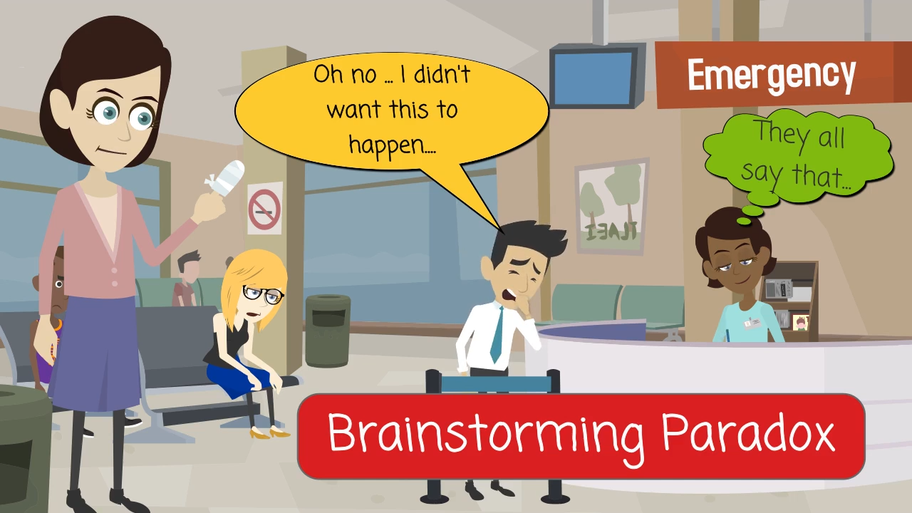

Slide 32
Brainstorming paradox
Brainstorming paradox is a modification of regular brainstorming .
events that must not occur are collected. Afterward, the group develops measures to prevent the events collected earlier from happening. Through this process, participants often realize which action may entail negative results. With this method, risks can be identified early on and countermeasures can be developed.
Advantages and disadvantages of this technique are identical to those of classic brainstorming.

Slide 33


Slide 34
Change of perspective:
Among the techniques that employ a change of Change of perspective
perspective (adopting different extreme standpoints), the most common technique is the so-called Six Thinking Hats [DeBono 2006].
Each of the six hats represents a particular perspective that is in turn
adopted by each of the participants. The resulting solutions approach the problem from different standpoints.
That way, even stakeholders that are very convinced of their own opinion are persuaded to adopt a different standpoint.
extraordinarily beneficial when stakeholders can only express their knowledge in a biased manner or are harshly constricted to their opinions.
cannot be applied if the requirements require a fine-grained level of detail because this would render the technique very laborious.

Slide 35
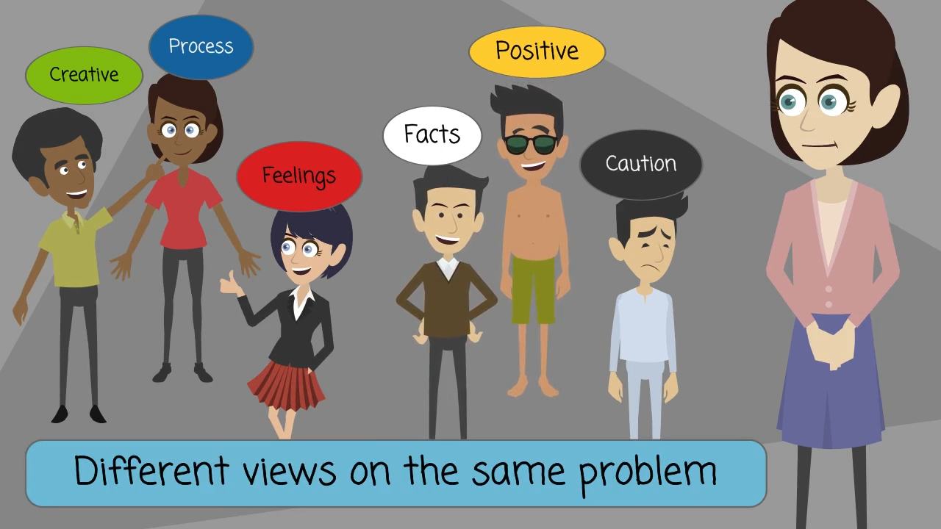

Slide 36
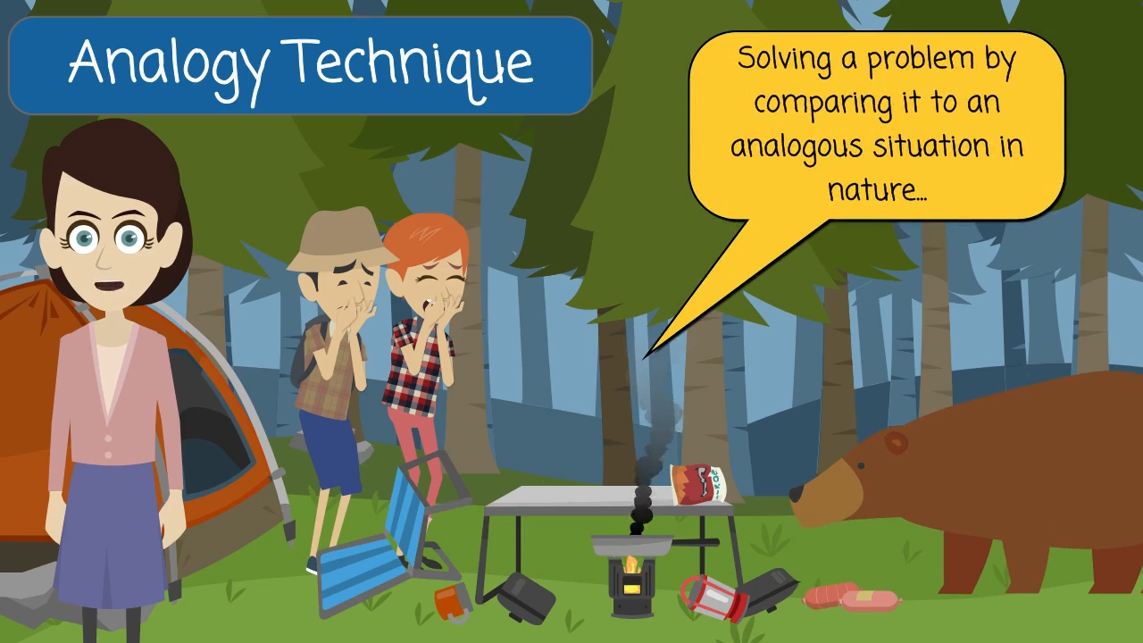

Slide 37
Analogy techniques (bionics/bisociations):
In bionics, problems that the project faces are mapped to an analogous
situation occurring in nature, and the solutions nature provides are sought and then mapped back to the project.
In bisociation, the analogies need not originate in nature. These techniques
assume that each participant is capable of analogous thinking, that a lot of
time is available, and that the participants have an in-depth knowledge of the domain with which an analogy will be drawn.
Analogy techniques can be applied covertly or in the open.
When this technique is applied covertly, the participants are only told the
analogy. The requirements engineer is then responsible for mapping the results onto the real problem space.
When this technique is applied in the open, the stakeholders know the real problem space as well as the analogy.

Slide 38
Document-centric Techniques
Document-centric techniques reuse solutions and experiences made with existing systems
System archaeology
Perspective-based reading
Reuse

Slide 39
System archaeology
System archaeology is a technique that extracts information required to
build a new system from the documentation or implementation (code) of a
legacy system or a competitor’s system.
By analyzing existing code, the requirements engineer ensures that none of the functionalities of the legacy system will be overlooked.
This method leads to a large amount of very detailed requirements and is very laborious.
only technique that can ensure that all functionalities of the legacy system will be implemented in the new system.
When it becomes obviously apparent that the legacy system and the new
system differ in functionality, additional elicitation techniques, e.g., creativity techniques, must be applied early on.

Slide 40
Perspective-based reading
Applied when documents need to be read with a particular perspective in mind, e.g., the perspective of the implementer or the tester.
Aspects that are contained in the document but do not pertain to the current perspective are ignored.
This allows for an analysis that is strictly focused on particular parts of the existing documentation. This way, detailed, technology related or implementation-related aspects can be separated from essential operational aspects that are relevant for the successor system.

Slide 41
Observation Techniques
Field observation
Apprenticing

Slide 42
When domain specialists are unable to spend the time needed to share their expertise with the requirements engineer, or are unable to express and denote their knowledge, observation techniques are helpful.
During observation, the requirements engineer observes the stakeholders while they go about their work.

Slide 43
Field observation: The requirements engineer is on location with the specialist or the users of the system and observes and documents the processes and operational procedures that they carry out. Using these observations, she formulates the requirements.
With apprenticing, the requirements engineer must actively learn and perform the procedures of the stakeholders. Just like an apprentice, the requirements engineer is encouraged to question unclear and complex operational procedures

Slide 44
Support Techniques
mind mapping
Workshop
CRC technique (CRC stands for Class Responsibility Collaboration)
Audio and video recordings
Use case modeling
Prototypes

Slide 45
Software requirement elicitation methodologies
CORE
IBIS
JAD
FODA
QFD etc..

Slide 46
Controlled Requirements Expression (CORE)
clarifies the user's view of the services to be supplied by the proposed
system and the limitations imposed by that system's operational
environment, in conjunction with some degree of performance and reliability investigation [Mullery 79].
CORE provides methods and notations for every phase of "elicitation,
specification and analysis of requirements, and results in a structured data flow form of specification" [Finkelstein 92].
CORE is a mature method with a set of guidelines on how to apply the
method to a problem [SDS 86]. The method is a flexible approach to
requirements elicitation, permitting it to be applied to a wide set of problems.
CORE encourages contributions from many different communities to develop requirements.

Slide 47
Controlled Requirements Expression (CORE)
CORE is a requirements elicitation, analysis and specification method.
Developed in 70’s and refined during 80’s.
View-point-based method.
CORE activities:
VP identification and selection (functional/non functional vps by partitioning the problem, brainstorming)
Data gathering (broad level data acquisition on each vp, functional vps structured in hierarchy)
Detailed viewpoint analysis (understand data, vp actions and their trigger, relationships b/w actions and data flow, event/control/information contaning data is acquired, isolated threads)
Systems analysis (isolated threads combined to get a consolidated picture of system)
Operational analysis (how individual threads fit in operational context)
Constraints analysis (NFPs)

Slide 48
Issue-based information systems (IBIS)
Developed by Horst Rittel, the IBIS method is based on the principle that the design process for complex problems, which Rittel terms "wicked" problems, is essentially an exchange among the stakeholders in which they bring their personal expertise and perspective to the resolution of design issues.
Simple and non-intrusive method that provides a framework for
resolving issues
gathering reqs while tracking pending issues
Documenting the rationale behind the requirements
IBIS enables capturing dialog information in a consistent way.
In IBIS, ideas are related to questions (issues)

Slide 49
Strong emphasis on finding the rationale behind the requirements.
Framework includes:
Question (issues)
Ideas (position)
Argument (justification)

Slide 50
IBIS does not address
Consistency problems
Resolving conflicts & consensus
Representation does not depict how old an issue is.
Strict fomat
Useful way of staying focused in meetings and documenting them consistently

Slide 51
Feature-Oriented Domain Analysis (FODA)
focuses on developing reusable assets
By examining related software systems and the underlying theory of the class of systems they represent, domain analysis can provide a generic description of the requirements of that class of systems in the form of a domain model and a set of approaches for their implementation.

Slide 52
FODA activities:
Context analysis (scope, defines extend/bounds of the domain for analysis)
Domain modeling (describes the problem space in the domain to be addressed by the software) Information model (ERDs), feature model, functional model (behavioral, structure the functions and sequences), domain terminology dictionary
Architecture modeling (system architecture, concurrent processes, common modules)
Focus is on understanding the domain and user’s perspective
Survey techniques are largely used

Slide 53
Joint Application Development (JAD)
JAD [Wood 95] is specifically designed for the development of large computer systems. The goal of JAD is to involve all stakeholders in the design phase of the product via highly structured and focused meetings. Typical participants in the session include a facilitator, end users of the product, main developers, and observers.
RE team is tasked with fact finding and information gathering. Typically, the outputs of this phase, as applied to requirements elicitation, are goals and artifacts. The actual JAD session is then used to validate this information by establishing an agreed-on set of requirements for the product.

Slide 54
JAD is a registered trademark of IBM corporation.
Early validation, all stakeholders, combined with CORE
Roles (Sponsor, facilitator, scribe, system specialists)
JAD activities
Project definition (fact finding, info gathering. What is required and what is not, project charter)
Forming JAD team (formed by facilitator & sponsor)
Kick-off
Regular JAD sessions for planning, analysis, design and development

Slide 55
Quality Function Deployment (QFD)
QFD is customer driven process that uses customers' requirements and prioritization to drive the functions that the product shall have and determines how these functions are made available.
Quality as the objective statement (the what is required)
Function is derived from quality and gives product characteristics to meet customer reqs
Deployment derived from function
In auto industry: customers reqs of car are used to derive design specifications, which are further used to derive part specifications

Slide 56
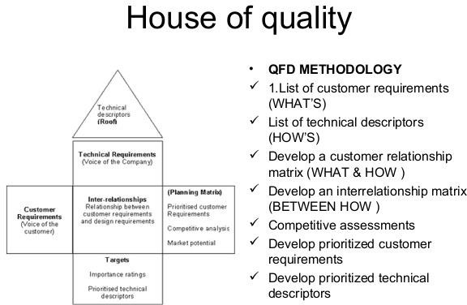

Slide 57
Quality Function Deployment (QFD)
QFD is “an overall concept that provides a means of translating customer requirements into the appropriate technical requirements for each stage of product development and production” [QFD 05].
The distinguishing attribute of QFD is the focus on customer needs throughout all product development activities.
By using QFD, organizations can promote teamwork, prioritize action items, define clear objectives, and reduce development time [QFD 05].

Slide 58
Although QFD covers a broad portion of the product development life cycle, the earlier stages of the process are applicable to requirements elicitation for software engineering. These stages include:
identifying the customer (stakeholders)
gathering high-level customer requirements
constructing a set of system features that can satisfy customer needs
creating a matrix to evaluate system features against satisfaction of customer needs
Note that the evaluation of features and needs could also be used for prioritization of requirements, in the context of a QFD requirements elicitation activity.

